Slide 1


UNIVERSITY COLLEGE OF ENGINEERING,
ANNA UNIVERSITY - BIT CAMPUS, TIRUCHIRAPPALLI -620 024
ANNA UNIVERSITY :: CHENNAI -620 025
INTERNIXA
AI-Monitored Learning Platform
Bridging the Gap Between Online Learning and Real-World Accountability
Presented by Ajeeth S
810022104308

Slide 2


The Problem with Online Learning Today
Current e-learning platforms have no mechanism to verify genuine student attention creating a systemic gap between course completion and actual learning.
🎭 No Attention Verification
📜 Time-Based Certificates
Students can play videos in the background without actively watching.
Certificates awarded purely on hours logged, not comprehension or focus.
📱 Digital Distractions
Multitasking and off-screen activity go completely undetected.

Slide 3
Problem Impact
The absence of real engagement monitoring has cascading consequences for learners, institutions, and the value of online education itself.
📉 Reduced Learning Quality
🎓 Fake Completions
Passive consumption replaces active understanding.
Courses marked complete without genuine participation.
🏅 Eroded Credibility
🔓 Trust Breakdown
Certificates lose trust when anyone can obtain them effortlessly.
Employers and institutions doubt the integrity of online credentials.

Slide 4

PROPOSED SOLUTION
Real Engagement, Verified
INTERNIXA introduces an AI-based engagement monitoring platform that operates in real time ensuring every minute of learning is genuine and accountable.
Real-Time Attention Tracking
Genuine Participation Enforcement
Engagement-Driven Certification
Continuously monitors student focus via webcam during active sessions.
Automatically intervenes when distraction is detected, preserving learning integrity.
Certificates are earned — not just collected — based on verified focus metrics.

Slide 5
Key Features
INTERNIXA's feature set is purpose-built to detect, respond to, and reward genuine learner engagement at every stage of the session.
Face Detection
Eye Gaze Tracking
Confirms the student's presence and identity throughout the session.
Monitors where the student is looking in real time.
Auto Video Pause
Distraction Alerts
Pauses playback automatically when distraction is detected.
Notifies the student to refocus with timely on-screen prompts.
Puzzle Verification
Engagement Certificate
Challenges the student to solve a puzzle before resuming the video.
Issued only when the student meets the minimum engagement threshold.

Slide 6
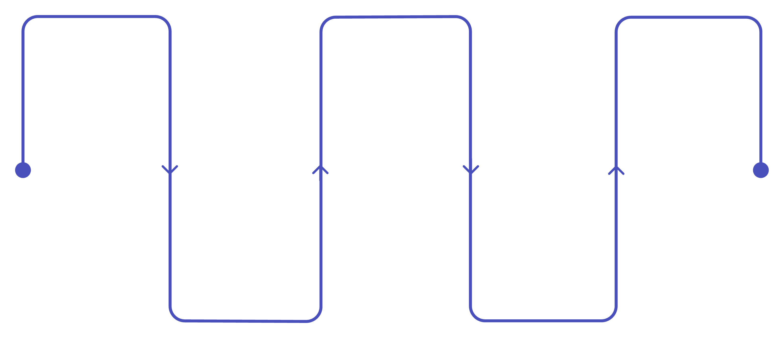
System Architecture
A streamlined end-to-end pipeline connects user authentication to certificate generation through continuous AI-driven monitoring at each stage.
Login
Webcam Activation
Focus Analysis
User authentication
Enable camera stream
Assess attention levels
Course Selection
Face Detection
Choose learning module
Locate and track face
Every stage is interconnected — distraction events trigger immediate responses while all focus data is persisted for final engagement evaluation.

Slide 7
Technology Stack
Frontend
Backend
React.js + Vite
FastAPI + Uvicorn
Fast, modular UI with hot-module replacement.
High-performance async REST API framework.
MediaPipe
MongoDB
Real-time facial landmark detection in the browser.
Flexible NoSQL storage for engagement session data.
YouTube API
JWT + Passlib
Seamless video embedding with programmatic playback control.
Secure token-based authentication and password hashing.

Slide 8

AI CORE
Focus Detection Engine
Powered by MediaPipe's 468-point facial landmark model, INTERNIXA calculates gaze direction in real time using eye and nose position vectors.
468 Facial Landmarks
Deviation Detection
800ms Delay Buffer
High-resolution mesh maps the entire face for precise spatial tracking.
Gaze deviation beyond a calibrated threshold flags a distraction event.
Prevents false positives from brief, natural head movements.

Slide 9


Engagement Metric & Certification Threshold
INTERNIXA calculates a precise, objective engagement score to determine certificate eligibility — replacing subjective time-logging with verifiable focus data.
The Formula
Certification Threshold
Engagement (%) = Active Time ÷ Total Time × 100
A minimum score of 75% is required to qualify for certificate generation.
Active time counts only periods of verified, uninterrupted attention.
Students below the threshold must re-engage with the course content.
75%
468
800ms
Minimum Threshold
Landmark Points
Alert Delay Buffer
Required to unlock the engagement-verified certificate.
Tracked per frame for high-fidelity gaze analysis.
Grace period to eliminate false distraction flags.

Slide 10

Conclusion & Future Scope
What INTERNIXA Delivers
Future Roadmap
Real Engagement in Learning
Emotion Detection
Eliminates passive consumption — every certified session is genuinely attended.
Gauge learner sentiment to adapt content difficulty in real time.
Restored Certificate Credibility
Employers and institutions can trust credentials backed by AI-verified focus data.
Multi-User Tracking
Scale monitoring to classroom and group learning environments.
LMS Integration
Plug into existing platforms like Moodle, Canvas, and Coursera.
INTERNIXA redefines what it means to earn a certificate — transforming online learning from a passive activity into a verified, accountable experience.

